Slide 1




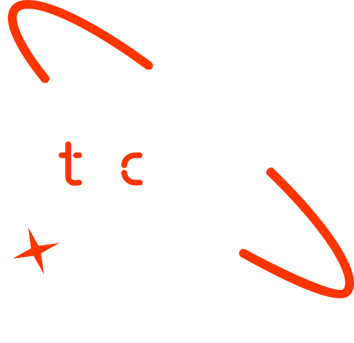

A new generation
of tech specialists

Slide 2
Crop Care

Slide 3
Outline
Concept note and implementation plan:​
Background​
Objectives​
SDG Relation​
Data​
Data Collection​
Exploratory Data Analysis (EDA) and Feature Engineering​
Model Selection and Training​
Model Evaluation and Hyperparameter Tuning​
Model Refinement and Testing​
Results​
Deployment​
Future Work

Slide 4
Concept Note and Implementation

Slide 5
Background
Brief project overview​
"Crop Care" develops a web app for real-time tomato leaf disease detection, soil health analysis, and treatment recommendations using machine learning.
Provide brief background​
Tomato crops are vulnerable to diseases, impacting yield and farmer income. Advanced technology offers solutions for early detection and management.
Importance of the problem being solved
Early detection and treatment recommendations for tomato diseases prevent yield losses, ensuring food security and reducing economic impact on farmers.

Slide 6
Objectives
Clearly state the project objectives​
Develop a user-friendly web application for real-time tomato leaf disease detection.
Implement soil health analysis to provide comprehensive crop management.
Integrate a recommendation system for actionable treatment suggestions.
Incorporate weather forecasting to predict conditions affecting crop health.
Outline what the machine learning model aims to achieve
Accurately detect and classify various tomato diseases from images using the YOLO v8 model.
Provide timely and accurate treatment recommendations to assist farmers in effective disease management.

Slide 7
SDG Relation
SDG 2: Zero Hunger: By improving tomato disease detection and management, the project aims to enhance crop yield and food security, contributing to the goal of ending hunger and achieving food security.
SDG 3: Good Health and Well-being: Ensuring healthy crops leads to the production of safer and more nutritious food, supporting overall public health and well-being.
SDG 12: Responsible Consumption and Production: The project promotes sustainable agricultural practices by optimizing disease management and minimizing the use of harmful pesticides, leading to more responsible production.
SDG 13: Climate Action: Integrating weather forecasting helps farmers adapt to climate-related impacts, fostering resilience in agricultural practices and contributing to climate action.

Slide 8
Data

Slide 9
Data Collection
Source(s) of the Dataset:
Data was collected from Roboflow, containing 17k images across 11 classes.
Preprocessing Steps during data collection:
During Data Collection Images were cleaned to remove irrelevant or corrupted data. Cropping, rotation, and segmentation were applied to standardize images.
Handling Missing Values, Outliers, etc.:
Missing values were handled by removing incomplete images. Outliers were identified and removed to ensure data quality and accuracy.

Slide 10
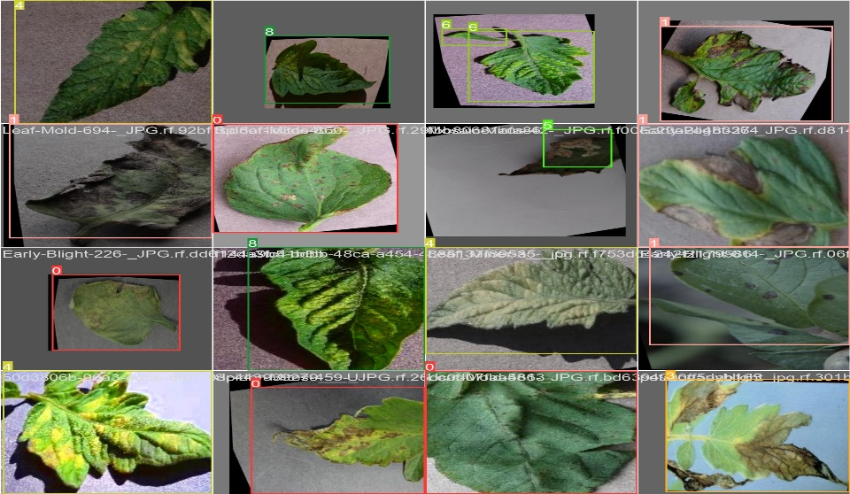
Exploratory Data Analysis (EDA) and Feature Engineering
Explain the process of creating or transforming features​
Preprocessing included auto-orienting, resizing to 512x512, and class adjustments. Applied augmentations such as flips, rotations, shearing, and exposure adjustments for enhanced image variety.
Rationale behind feature engineering decisions​
Standardizing images ensures uniformity for model training, while augmentations increase data diversity, improving model robustness. Color and texture analysis are crucial for accurate disease identification.
Describe scaling, normalization, encoding, etc.​
Images scaled uniformly, pixel values normalized to 0-1 range, and categorical data encoded numerically using one-hot encoding to ensure data consistency and compatibility with machine learning models.

Slide 11
Model

Slide 12
Model Selection and Training
Rationale for choosing a specific model​
YOLO v8 was chosen for its efficiency and accuracy in real-time object detection, making it ideal for identifying tomato diseases quickly and accurately.
Discuss the strengths and weaknesses​
Strengths: High accuracy, real-time detection capabilities, efficient computation, robust performance with large datasets.
Weaknesses: Requires substantial computational resources, complex to fine-tune, performance may degrade with highly similar disease symptoms

Slide 13
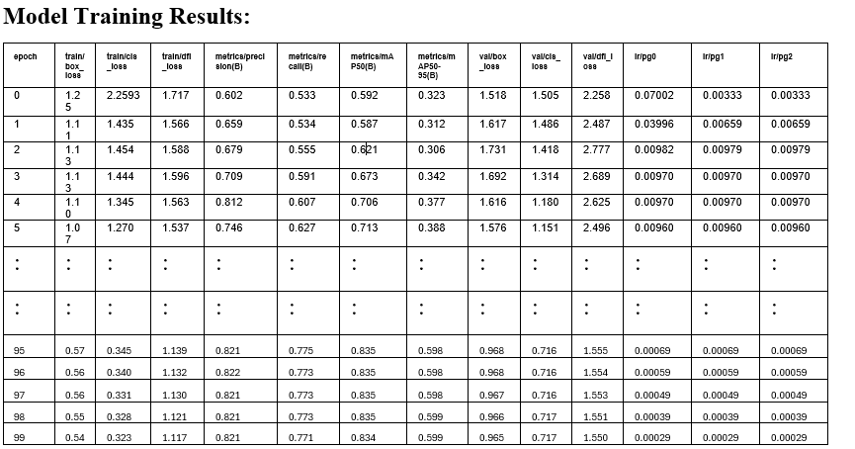
Model Selection and Training
Details on training the model​
The model was trained using a dataset from Roboflow with 17k images across 11 classes. Preprocessing steps included resizing, augmentations (flips, rotations, shearing, exposure adjustments), and normalization.
Hyperparameters used and any cross-validation techniques​
Hyperparameters: Learning rate, batch size, number of epochs, weight decay.
Cross-Validation: K-fold cross-validation was used to ensure model generalizability and to prevent overfitting.

Slide 14
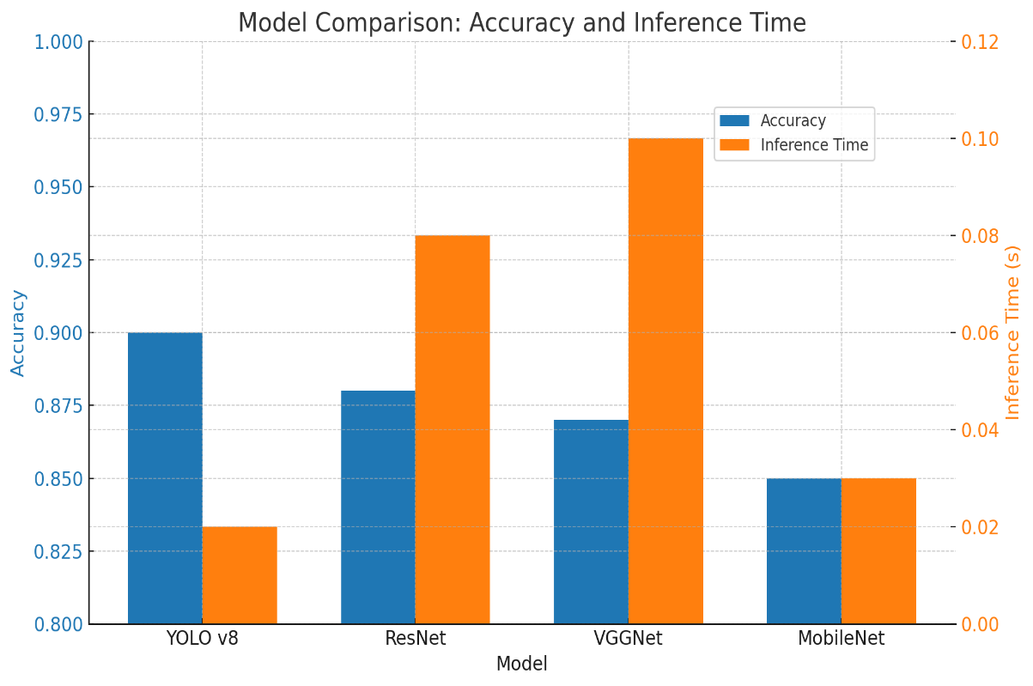
Model Selection and Training
Comparison of Models:
YOLO v8: Best for real-time detection with high accuracy.
ResNet: High accuracy but slower inference times, more suited for non-real-time applications.
VGGNet: Good accuracy, but larger and slower compared to YOLO v8.
MobileNet: Faster and lighter but with slightly lower accuracy compared to YOLO v8.

Slide 15
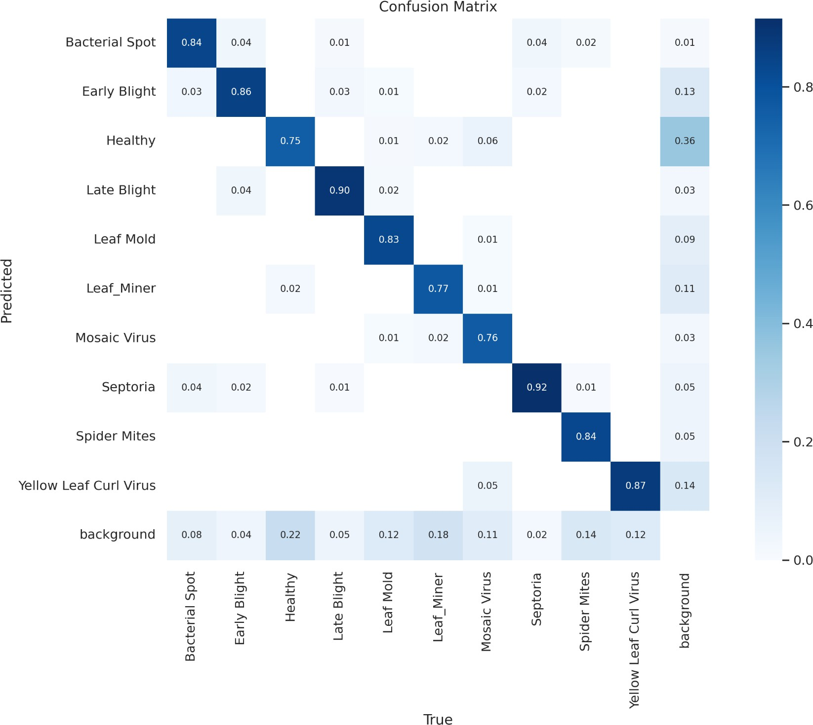
Model Evaluation and Hyperparameter Tuning
Model Performance Metrics
Precision and Recall: High precision and recall values indicate accurate disease detection with minimal false positives and false negatives.
Confusion Matrix: Shows robust performance across most disease classes, with high accuracy in identifying specific diseases.
Average Accuracy: The model achieved an average accuracy of around 86Training and Validation Analysis: Loss Curves: Consistent decrease in both training and validation losses over 100 epochs indicates effective learning and generalization. Hyperparameter Tuning: Adjustments to learning rate and batch size improved model convergence speed and overall accuracy.

Slide 16
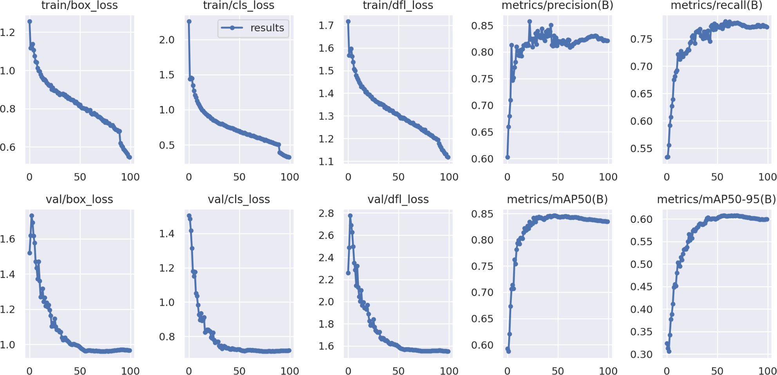
Model Evaluation and Hyperparameter Tuning
Training and Validation Analysis:
Loss Curves: Consistent decrease in both training and validation losses over 100 epochs indicates effective learning and generalization.
Hyperparameter Tuning: Adjustments to learning rate and batch size improved model convergence speed and overall accuracy.

Slide 17
Model Refinement and Testing
Refinement Phase:
Techniques: Hyperparameter tuning, data augmentation, and cross-validation.
Aim: Enhance model accuracy and generalization.
Model Improvement
Techniques: Applied learning rate adjustments and batch size optimization. Implemented additional data augmentations like flipping, rotation, and scaling.
Test Submission Phase:
Final model evaluated on a separate test dataset. Metrics: Precision, recall, and overall accuracy.
Test Dataset Results: Achieved average accuracy around 90%. Consistent performance across multiple disease classes as shown in the confusion matrix.

Slide 18
Result

Slide 19
Evaluation Results

Slide 20
Deployment

Slide 21
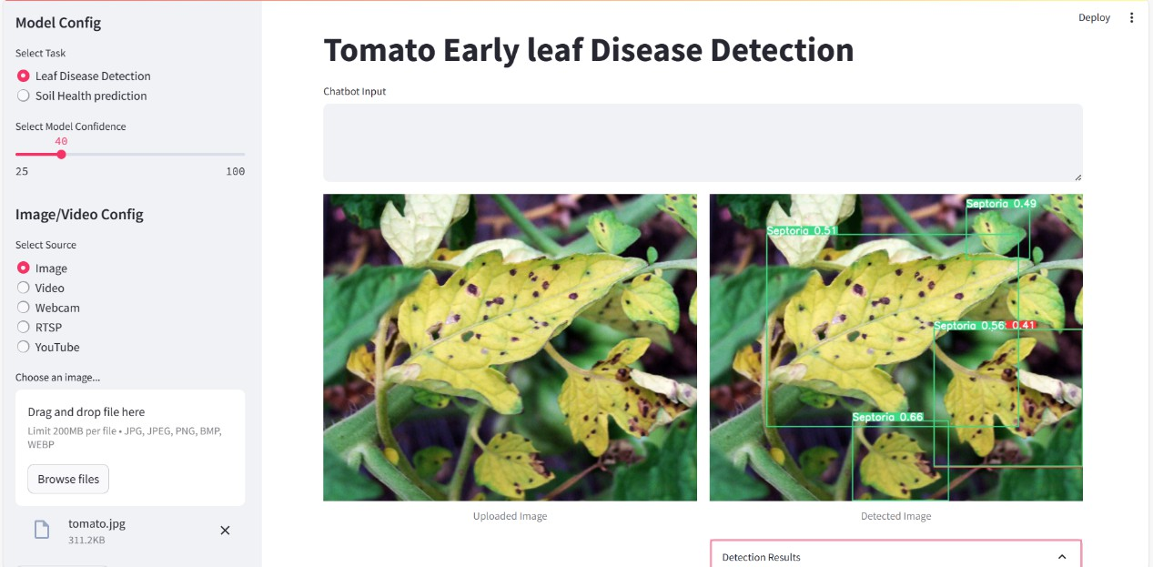
Deployment
Deployment Phase:
Developed a Streamlit app for user-friendly interaction and real-time disease detection.
Model Serialization:
Serialized the trained model using joblib for efficient storage and loading. Ensures quick model loading during inference. ​

Slide 22
Conclusion and Futurework
Conclusion:
The "Crop Care" project successfully developed a user-friendly web application for real-time tomato leaf disease detection and Fertilizer Recommendation.
The model achieved an average accuracy of around 90%, demonstrating strong performance across various disease classes.
Integration of a recommendation system and weather forecasting module enhanced the app's utility for farmers.
Future Work:
Expand the disease database to include more crop types and diseases.
Improve model accuracy by incorporating more advanced machine learning techniques.
Integrate IoT devices for real-time environmental data collection and analysis.
Enhance the user interface and add multi-language support to reach a broader audience.

Slide 23

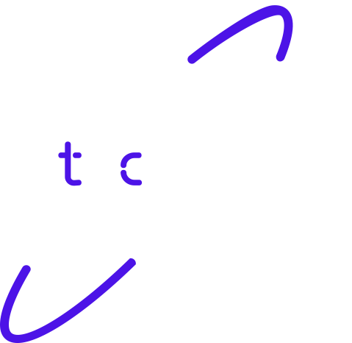
Thank you!

